Slide 1
Java Capability
Introduction to Java

Slide 2
Agenda
Introduction to Java
History and Features of Java
Internals of Java Program
c) Difference between JDK,JRE and JVM
d) Internal Details of JVM
e) Variable and Data Type
f) Naming Convention
Control Statements
a) If – else
b) Switch – case
c) For Loop
d) While loop
e) Do ..while loop
f) Break
g) Continue
h) Comments
i) Arrrays

Slide 3
Prerequisites
Basic Programming Language like C,etc.
OOPS would be added advantage.

Slide 4
What is Java?
Java is a programming language and a platform.
Java is a high level, robust, secured and object-oriented programming language.
Platform: Any hardware or software environment in which a program runs, is known as a platform. Since Java has its own runtime environment (JRE) and API, it is called platform.
Java programming language was originally developed by Sun Microsystems which was initiated by James Gosling and released in 1995 as core component of Sun Microsystems' Java platform (Java 1.0 [J2SE]).
The latest release of the Java Standard Edition is Java SE 14.
Cmd > javac –version // Java compiler version
Cmd> java -version // Java interpreter version

Slide 5
Types of Java Applications
1) Standalone Application
It is also known as desktop application or window-based application. AWT and Swing are used in java for creating standalone applications.
2) Web Application
An application that runs on the server side and creates dynamic page, is called web application. Servlet, JSP, Struts, JSF etc. technologies are used for creating web applications in java.
3) Enterprise Application
An application that is distributed in nature, such as banking applications etc. It has the advantage of high level security, load balancing and clustering. In java, EJB is used for creating enterprise applications.
4) Micro Edition
An application that is created for mobile devices.

Slide 6
Features of Java
Object Oriented − In Java, everything is an Object. Java can be easily extended since it is based on the Object model.
Platform Independent − Unlike many other programming languages including C and C++, when Java is compiled, it is not compiled into platform specific machine, rather into platform independent byte code. This byte code is distributed over the web and interpreted by the Virtual Machine (JVM) on whichever platform it is being run on.
Simple − Java is designed to be easy to learn. If you understand the basic concept of OOP Java, it would be easy to master.

Slide 7
JVM
JVM (Java Virtual Machine) is an abstract machine. It is a specification that provides runtime environment in which java bytecode(.class) can be executed.
JVMs are available for many hardware and software platforms. JVM, JRE and JDK are platform dependent because configuration of each OS differs. But, Java is platform independent.
The JVM performs following main tasks:
Loads code
Verifies code
Executes code
Provides runtime environment

Slide 8
JAVA ARCHITECTURE
Class Loader
Java Class
Libraries
Java
Source
(.java)
Bytecode Verifier
Java
Bytecodes
move locally
or through
network
Java
Interpreter
Just in Time
Compiler
Java Compiler
Java
Virtual
machine
Runtime System
Java
Bytecode
(.class )
Operating System
Hardware

Slide 9
JRE & JDK
JRE is an acronym for Java Runtime Environment. It is used to provide runtime environment. It is the implementation of JVM. It contains set of libraries and other files that JVM uses at runtime.
Implementation of JVMs are also actively released by other companies besides Sun Micro Systems which is acquired by Oracle.
JDK is an acronym for Java Development Kit. It contains JRE and development tools.

Slide 10
How to set path in Java?
There are 2 ways to set java path:
Temporary
Permanent
How to set Temporary Path of JDK in Windows
To set the temporary path of JDK, you need to follow following steps:
Open command prompt
copy the path of jdk1.8/bin directory
write in command prompt: set path=copied_path;%path%

Slide 11
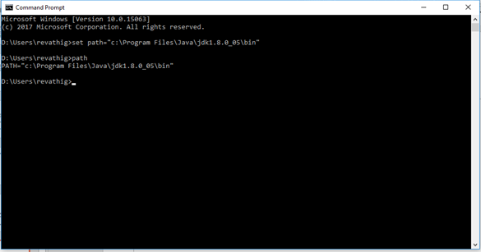
How to set Temporary Path of JDK in Windows

Slide 12
How to set Permanent Path of JDK in Windows
For setting the permanent path of JDK, you need to follow these steps:
Go to MyComputer properties -> advanced tab -> environment variables -> new tab of user variable -> write path in variable name -> write path of bin folder in variable value -> ok -> ok -> ok

Slide 13
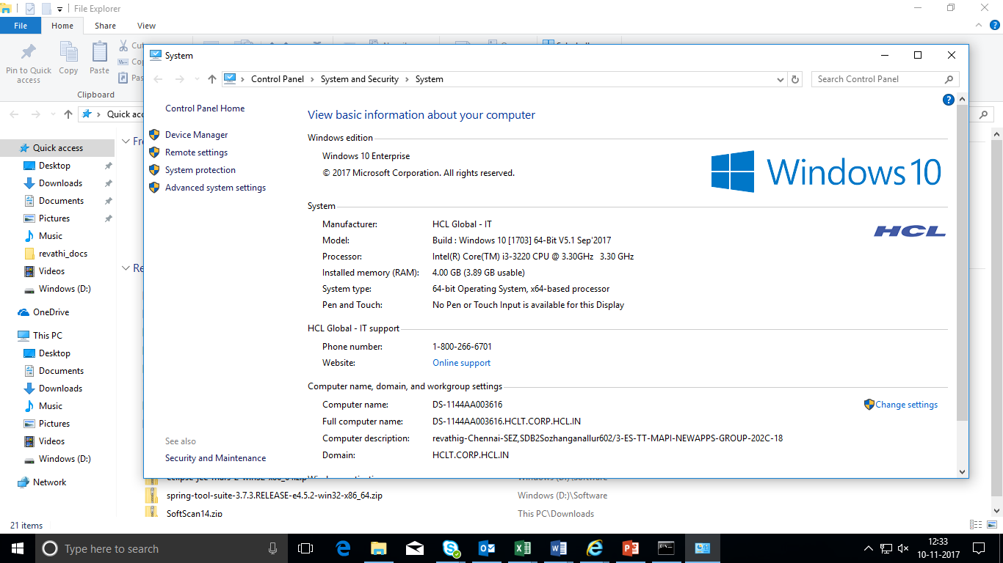
How to set Permanent Path of JDK in Windows - contd.….

Slide 14
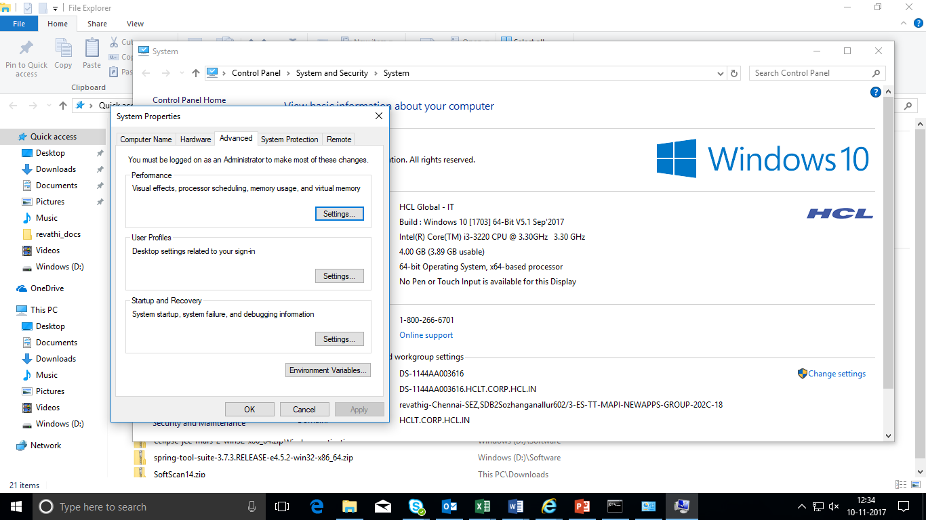
How to set Permanent Path of JDK in Windows - contd.….

Slide 15
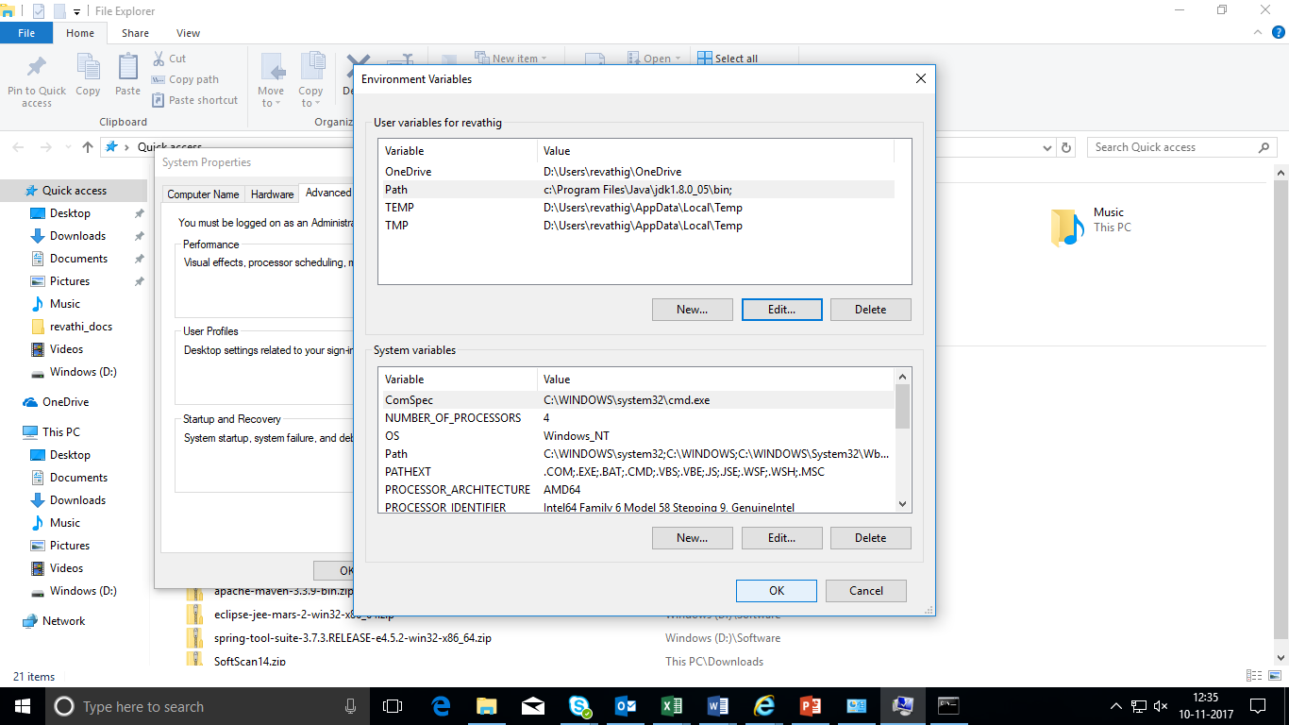
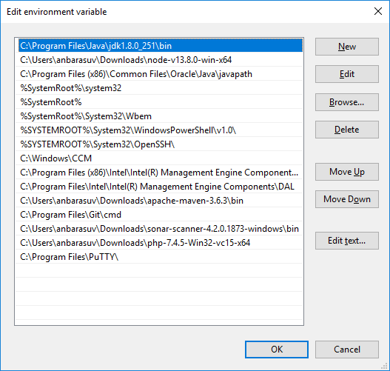
How to set Permanent Path of JDK in Windows - contd.….

Slide 16
Popular Java Editors
To write your Java programs, you will need any text editor. There are even more sophisticated IDEs available in the market. But for now, you can consider one of the following −
Notepad − On Windows machine, you can use any simple text editor like Notepad (Recommended for this tutorial), TextPad.
IDE
Netbeans − A Java IDE that is open-source and free which can be downloaded from https://www.netbeans.org/index.html.
Eclipse − A Java IDE developed by the eclipse open-source community and can be downloaded from https://www.eclipse.org/.

Slide 17
Example
public class Sample{
public static void main(String[ ] args){
System.out.println(“Welcome to core Java");
}
}
Save this file as Sample.java
To compile: cmd > javac Sample.java
To execute: cmd > java Sample
Output:
Welcome to core Java

Slide 18
Definition
class keyword is used to declare a class in java.
public keyword is an access modifier which represents visibility, it means it is visible to all.
static is a keyword, if we declare any method as static, it is known as static method. The core advantage of static method is that there is no need to create object to invoke the static method. The main method is executed by the JVM, so it doesn't require to create object to invoke the main method. So it saves memory.
void is the return type of the method, it means it doesn't return any value.
main represents startup of the program.
String[ ] args is used for command line arguments.
System.out.println( ) is used print statement.

Slide 19
LANGUAGE BASICS
Keywords
Data Types
Variables
Operators
Conditional Statements
Loops

Slide 20
JAVA KEYWORDS
abstract | continue | for | new | switch
assert | default | goto | package | synchronized
boolean | do | if | private | this
break | double | implements | protected | throw
byte | else | import | public | throws
case | enum | instanceof | return | transient
catch | extends | int | short | try
char | final | interface | static | void
class | finally | long | strictfp | volatile
const | float | native | super | while
Notes:
The keywords const and goto are reserved but not yet defined in java.

Slide 21
PRIMITIVE DATA TYPES
Data Type | Size (in bits) | Minimum Range | Maximum Range | Default Value (for fields)
byte | 8 | -128 | +127 | 0
short | 16 | -32768 | +32767 | 0
int | 32 | -2147483648 | +2147483647 | 0
long | 64 | -9223372036854775808 | +9223372036854775807 | 0L
float | 32 | 1.40E-45 | 3.40282346638528860e+38 | 0.0f
double | 64 | 4.94065645841246544e-324d | 1.79769313486231570e+308d | 0.0d
char | 16 |  | 0 to 65,535 | '\u0000'
boolean | 1 | NA | NA | false
Notes:
Java does not have unsigned types for numbers.
The range is defined by the Java programming language specification as a two’s complement and is platform independent.
A variable is an item of data named by an identifier. You must explicitly provide a name and a type for each variable you want to use in your program. The variable's name must be a legal identifier - an unlimited series of Unicode characters that begins with a letter or dollar($) or underscore (_). You use the variable name to refer to the data that the variable contains. The variable's type determines what values it can hold and what operations can be performed on it. To give a variable a type and a name, you write a variable declaration, which generally looks like this: type name
In addition to the name and type that you explicitly give a variable, a variable has scope. The section of code where the variable's simple name can be used is the variable's scope. The variable's scope is determined implicitly by the location of the variable declaration, that is, where the declaration appears in relation to other code elements.
When you declare a variable, you explicitly set the variable's name and data type. The Java programming language has two categories of data types: primitive and reference. A variable of primitive type contains a value (Campione, Walrath & Huml, 2001, p.67).
The location of a variable declaration implicitly sets the variable's scope, which determines what section of code may refer to the variable by its simple name. There are four categories of scope: member variable scope, local variable scope, parameter scope, and exception-handler parameter scope (Malyarenko, 2006).
Integral - byte, short, int, and long
There are four integral types in the Java programming language. Each type is declared using one of the keywords byte, short, int, or long. You can represent literals of integral types using decimal, octal, or hexadecimal forms as follows :
2 The decimal value is two.
077 The leading zero indicates an octal value.
0xBAAC The leading 0x indicates a hexadecimal value.
NOTE: All integral types in the Java programming language are signed numbers. Integral literals are of type int unless explicitly followed by the letter “L”, which indicates a long value.

Slide 22
TYPES OF VARIABLES
The Java programming language defines the following kinds of Variables:
Local Variables
Tied to a method.
Scope of a local variable is within the method or Curly brackets- { }.
Instance Variables (Non-static)
Tied to an object.
Scope of an instance variable is the whole class.
Static Variables
Tied to a class.
Shared by all instances of a class.
Notes:
Variables - A variable or an identifier is a “named container”that holds a value. It can letters, digits, underscores, dollar signs, but does not begin with a digit and contains no spaces. Variables can be of different data types: int, char, double, boolean, etc. Variables can also hold objects; then the type is the class of the object. The programmer gives names to variables. Names of variables usually start with a lowercase letter. More precisely, variables that represent objects hold references to (basically addresses of) objects. The space to hold the actual object is allocated elsewhere. Names of variables must be meaningful, not too long, and not too short. If a name consists of several words, the subsequent words are capitalized.
Local Variables - are declared inside a constructor or a method. Local variables are for temporary use; they are created when you call a method and destroyed when you return from a method call. The scope of a local variable is from its declaration down to the closing brace of the block in which it is declared. If you create a temporary object in a method using new and then assign it to a local variable, then the object is destroyed automatically when the method is exited and its memory is released. Java has a “garbage collector" run-time mechanism to do that.

Slide 23
QUIZ
Match the following table:
What will be the output for the below code ?
public class Sample{
public static void main(String [ ] arg) {
int val;
System.out.println(" value: " + val);
} }
DATA TYPES | SIZE(bits)
char | 32
byte | 16
int | 8
double | 64
Output:
Compiler Error
Notes:
Answers:
1. char 2; byte 1; int 4; double 8
2. Error: local variable i_val is not initialized

Slide 24
operators
Java provides a set of operators to manipulate operations.
Types of operators in java are,
Arithmetic Operators
Unary Operator
Relational Operators
Logical Operators
Simple Assignment Operator

Slide 25
Arithmetic Operators
Operator | Description | Example
+ | Addition | A + B
- | Subtraction | A - B
* | Multiplication | A * B
/ | Division | A/B
% | Modulus | A%B

Slide 26
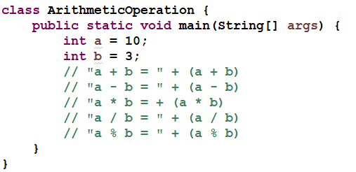
Arithmetic Operators - Example

Slide 27
UNARY OPERATORS
Operator | Description | Example
+ | Unary plus operator | +A
- | Unary minus operator | -A
++ | Increment operator | ++A or A++
-- | Decrement operator | --A or A--

Slide 28
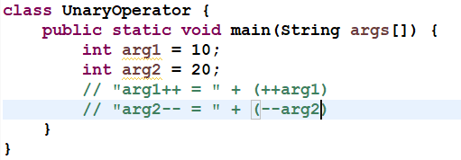
UNARY OPERATORS - EXAMPLE

Slide 29
RELATIONAL OPERATORS
Operator | Description | Example
== | Two values are checked, and if equal, then the condition becomes true | (A == B)
!= | Two values are checked to determine whether they are equal or not, and if not equal, then the condition becomes true | (A != B)
> | Two values are checked and if the value on the left is greater than the value on the right, then the condition becomes true. | (A > B)
< | Two values are checked and if the value on the left is less than the value on the right, then the condition becomes true | (A < B)
>= | Two values are checked and if the value on the left is greater than equal to the value on the right, then the condition becomes true | (A >= B)
<= | Two values are checked and if the value on the left is less than equal to the value on the right, then the condition becomes true | (A <= B)

Slide 30
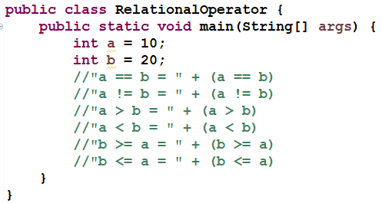
RELATIONAL OPERATORS - eXAMPLE

Slide 31
LOGICAL OPERATORS
Operator | Description | Example
&& | This is known as Logical AND & it combines two variables or expressions and if and only if both the operands are true, then it will return true | (A && B) is false
|| | This is known as Logical OR & it combines two variables or expressions and if either one is true or both the operands are true, then it will return true | (A || B) is true
! | Called Logical NOT Operator. It reverses the value of a Boolean expression | !(A && B) is true

Slide 32
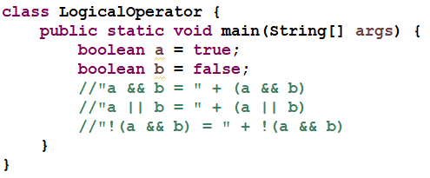
LOGICAL OPERATORS - eXAMPLE
/* Example to understand logical operator */

Slide 33
SIMPLE ASSIGNMENT OPERATOR
= Simple assignment operator
Which assigns right hand side value to left hand side variable
Ex:
int a;
a = 10;

Slide 34
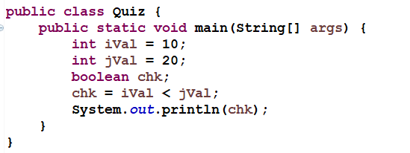
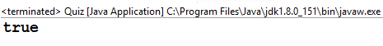
QUIZ
What will be the output for the below code ?
Notes:
Answer:
Chk value: true

Slide 35
Control Statements
There may be a situation when you need to execute a block of code several number of times.
In general, statements are executed sequentially: The first statement in a function is executed first, followed by the second, and so on.
Programming languages provide various control structures that allow for more complicated execution paths.
Two types Statements
→Decision Making
→Loop Control

Slide 36
Decision Making
Decision making structures have one or more conditions to be evaluated or tested by the program, along with a statement or statements that are to be executed if the condition is determined to be true, and optionally, other statements to be executed if the condition is determined to be false.
→Switch
→If ..else

Slide 37
Java – Loop Control
A loop statement allows us to execute a statement or group of statements multiple times.
→While
→Do-while
→For

Slide 38
Java Switch Statement
The Java switch statement executes one statement from multiple conditions. It is like if-else-if ladder statement.
Syntax
switch(expression){
case value1: //code to be executed;
break; //optional
case value2: //code to be executed;
break; //optional
default: //code to be executed if all cases are not matched;
}

Slide 39
Java If-else Statement
The Java if statement is used to test the condition. It checks boolean condition: true or false. There are various types of if statement in java.
if statement
if-else statement
if-else-if ladder
nested if statement
Syntax:
if(condition){
//code if condition is true
} else {
//code if condition is false
}

Slide 40
While Loop
The Java while loop is used to iterate a part of the program several times. If the number of iteration is not fixed, it is recommended to use while loop.
Syntax:
while(condition){
//code to be executed
}

Slide 41
Do-While
A do...while loop is similar to a while loop, except that a do...while loop is guaranteed to execute at least one time.
Syntax:
do{
//code to be executed
}while(condition);

Slide 42
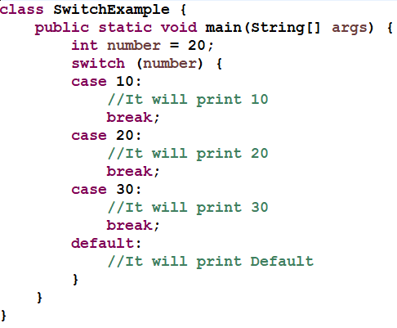
Quiz
Predict the output:

Slide 43
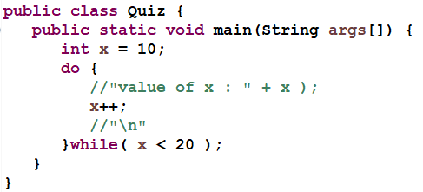
Quiz
Predict the output:

Slide 44
break
Loop control statements change execution from its normal sequence. When execution leaves a scope, all automatic objects that were created in that scope are destroyed
Java Break Statement
The Java break is used to break loop or switch statement. It breaks the current flow of the program at specified condition. In case of inner loop, it breaks only inner loop.
Syntax:
break;

Slide 45
Continue
Java Continue Statement
The Java continue statement is used to continue loop. It continues the current flow of the program and skips the remaining code at specified condition. In case of inner loop, it continues only inner loop.
Syntax:
continue;

Slide 46
Quiz
Predict the output.
public class ContinueExample {
public static void main(String[] args) {
for(int i=1;i<=10;i++){
if(i==5){
continue;
}
System.out.println(i);
}
}
}

Slide 47
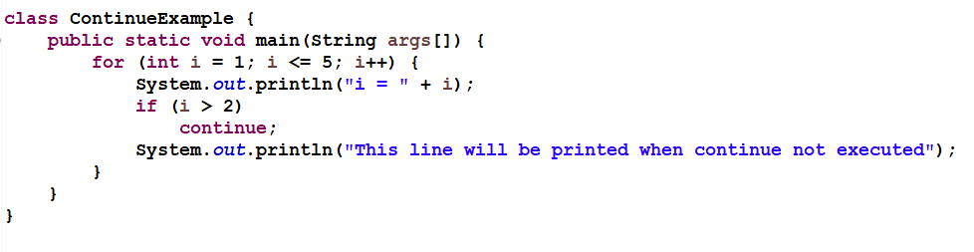
QUIZ
Predict the output

Slide 48
Eclipse - ide
An integrated development environment (IDE) is a software application .
An IDE normally consists of a source code editor, build automation tools, and a debugger.
Most modern IDEs have intelligent code completion.
Eclipse is a universal tool platform - an open, extensible IDE for anything.

Slide 49
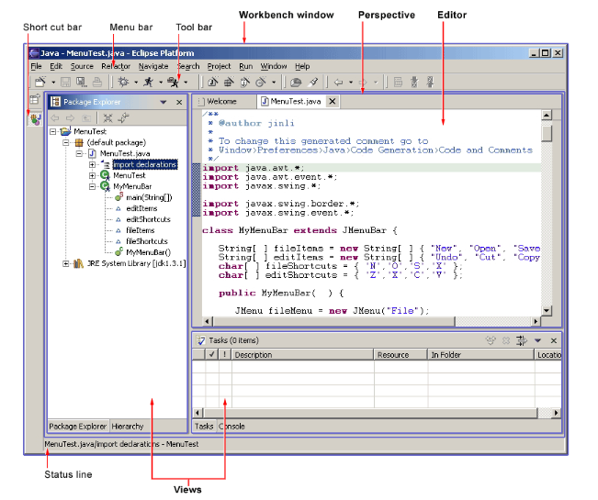
The Workbench
Eclipse workbench user interface

Slide 50
Eclipse Keyboard Shortcuts for Java Programmer
Hot keys | Description
Ctrl + Shift + T | for finding class even from jar.
Ctrl + Shift + R | for finding any resource (file) including config XML files
Ctrl + 1 | Eclipse shortcut which can fix up any error for you in Eclipse.
Ctrl + Shift + o | for organize imports.
Ctrl + o | for quick outline going quickly to method.
Alt + right and Alt + left | for going back and forth while editing.
Alt + Shift + W | for show in package explorer.
Ctrl + k and Ctrl + Shift +K | for find next/previous.
Ctrl + / | for commenting, uncommenting lines and blocks.
Ctrl + Shift + / | for commenting, uncommenting lines with block comment.

Slide 51
Eclipse Keyboard Shortcuts for Java Programmer
Hot keys | Description
Ctrl + F4 or Ctrl + w | for closing current file.
Ctrl+Shirt+W | for closing all files.
Ctrl + l | go to line.
Ctrl + F | for find, find/replace.
Ctrl + D | to delete a line.
Ctrl+Shift+L | to view the listing for all Eclipse keyboard shortcuts.
Alt + Shift + j | to add Javadoc at any place in Java source file.
CTRL+SHIFT+P | to find closing brace.
Ctrl + Shift +F | for Autoformatting.

Slide 52
Getting Started With Eclipse
Start Eclipse.
Create a new Java Project:
File->New->Project.
Select "Java" in the category list.
Select "Java Project" in the project list. Click "Next".
Enter a project name into the Project name field, for example, “FirstProject".
Click "Finish"--It will ask you if you want the Java perspective to open. (You do.)
Create a new Java class:
Click the "Create a Java Class" button in the toolbar. (This is the icon below "Run" and "Window" with a tooltip that says "New Java Class.")
Enter "HelloWorld" into the Name field.
Click the checkbox indicating that you would like Eclipse to create a "public static void main(String[] args)" method.
Click "Finish".
A Java editor for HelloWorld.java will open. In the main method enter the following line. System.out.println("Hello World");
Save using ctrl-s. This automatically compiles HelloWorld.java.
Click the "Run" button in the toolbar (looks like a little man running).
You will be prompted to create a Launch configuration. Select "Java Application" and click "New".
Click "Run" to run the Hello World program. The console will open and display " Hello World ".

Slide 53
PASS COMMAND-LINE ARGUMENTS IN ECLIPSE IDE
public class AdditionOfTwoNumbers {
public static void main(String[] args) {
//int a, b; //do not declare multiple variables in a line
int a = Integer.parseInt(args[0]); //4 bytes – 32 bits
int b = Integer.parseInt(args[1]); //4 bytes – 32 bits
// int sum = a + b; //4 bytes – 32 bits
System.out.println("The Sum is: " + (a+b)); //display
}
}
Press [Ctrl + s] to save your program

Slide 54
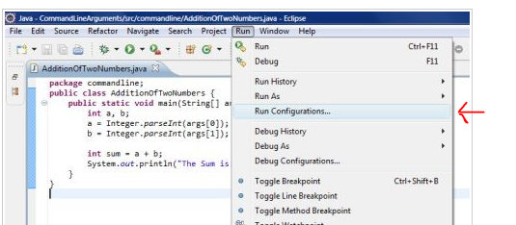
PASS COMMAND-LINE ARGUMENTS IN ECLIPSE IDE
Go to Run menu of eclipse and select Run Configurations. Run Configurations dialogue box opens.

Slide 55
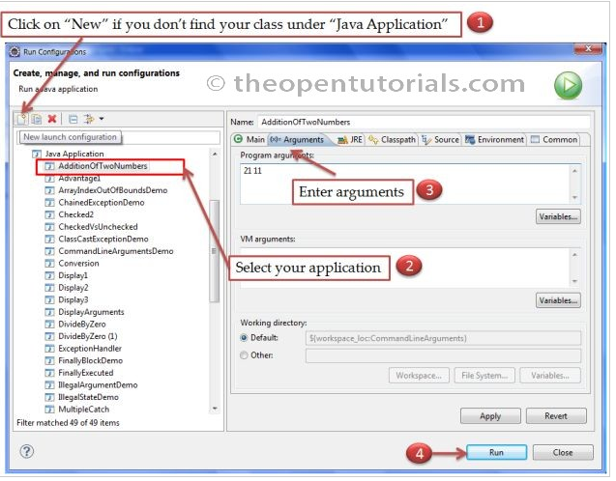
PASS COMMAND-LINE ARGUMENTS IN ECLIPSE IDE
Select your Java class from the left side column under "Java Application". If you do not find your class, then click on the “New launch Configuration” button, found above the class list under "Java Application". (use Browse, Select button to your project and main class “”)
In the right side menu select “Arguments” tab
In the “Program Arguments” text area type the input numbers separated by spaces or newline.
Click Run button.

Slide 56
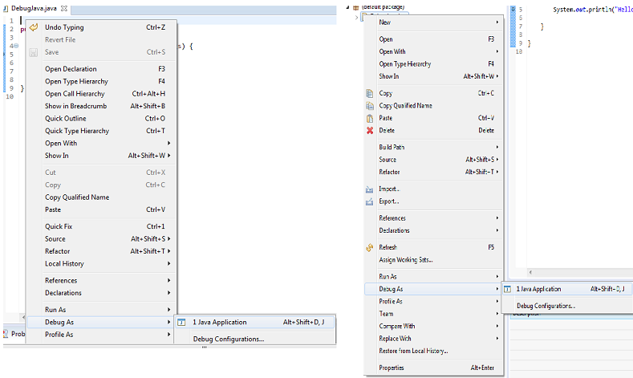
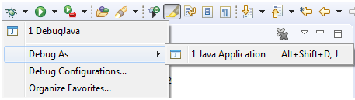
Debugging
1. Launching and Debugging a Java program
A Java program can be debugged simply by right clicking on the Java editor class file from Package explorer. Select Debug As → Java Application or use the shortcut Alt + Shift + D, J instead.

Slide 57
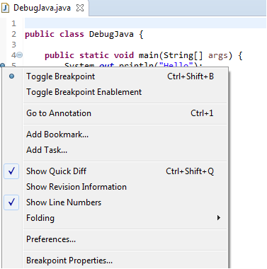
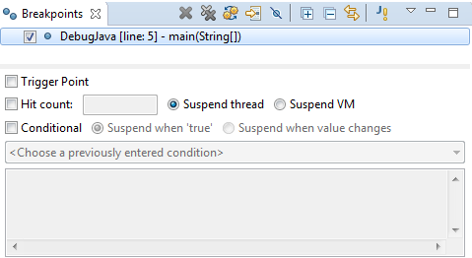
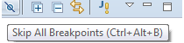
Breakpoints
A breakpoint is a signal that tells the debugger to temporarily suspend execution of your program at a certain point in the code.
To define a breakpoint in your source code, right-click in the left margin in the Java editor and select Toggle Breakpoint. Alternatively, you can double-click on this position.

Slide 58
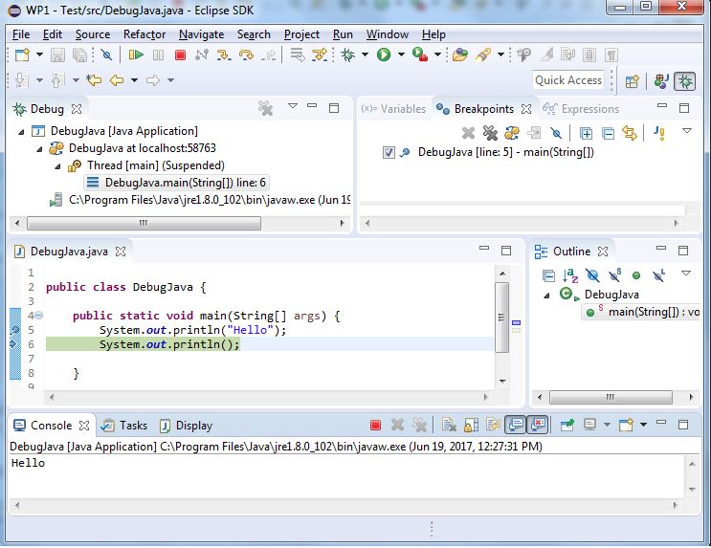
Debug Perspective
Debug view – Visualizes call stack and provides operations on that.
Breakpoints view – Shows all the breakpoints.
Variables/Expression view – Shows the declared variables and their values. Press Ctrl+Shift+d or Ctrl+Shift+i on a selected variable or expression to show its value. You can also add a permanent watch on an expression/variable that will then be shown in the Expressions view when debugging is on.
Display view – Allows to Inspect the value of a variable, expression or selected text during debugging.
Console view – Program output is shown here.

Slide 59
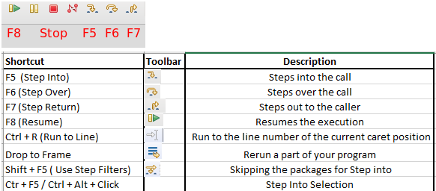
Stepping commands

Slide 60
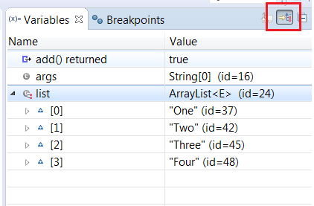
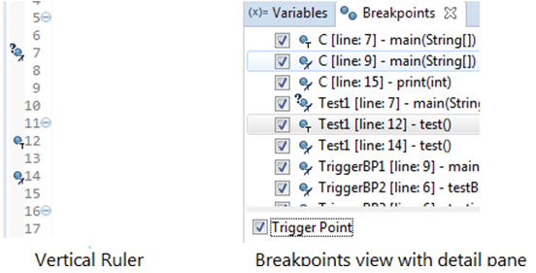
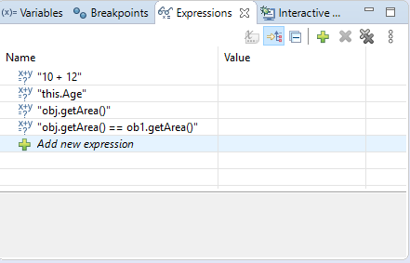
Debug - Windows

Slide 61
References & Further Studies
https://docs.oracle.com/javase/9/
https://docs.oracle.com/javase/tutorial/
https://www.tutorialspoint.com/java8/java8_overview.htm
Notes:
Answer:
Error: Invalid array object creation
61

